Slide 1
BURROW-WHEELERS TRANSFORM
Done by:
ABIJITH PRADEEP (CB.EN.U4AIE19002)
G. ROHITH (CB.EN.U4AIE19026)
LAKSHAYA K (CB.EN.U4AIE19039)
SANJAY B (CB.EN.U4AIE19056)

Slide 2
Table of Contents
Theory of Burrow-Wheelers Transform
Algorithm & Implementation of BWT
Theory of Inverse Burrow-Wheelers Transform
Algorithm & Implementation of IBWT
Genome reconstruction & Code
Pattern Counting & Code
Pattern Searching & Code
Compression & Code

Slide 3
What is BWT?
The Burrows–Wheeler transform (BWT) rearranges a character string into runs of similar characters.
More importantly, the transformation is reversible, without needing to store any additional data except the position of the first original character.
The BWT is thus a "free" method of improving the efficiency of text compression algorithms, costing only some extra computation.

Slide 4
Example
T1 = panamabananas
BWT(T1) = smnpbnnaaaaa$a
T2 = appellee
BWT(T2) = e$elplepa
Possible reason for this could be the already present runs in the original string. However, BWT is usually used for strings with larger lengths - eradicating this problem

Slide 5
How is the BWT done?
Append a dollar to end of the string being transformed.
Create a table of cyclic rotations
(rotating the last character and the first character for the length of the string)
Sort the BWT table.
BWT of the string → last column of the BWT table

Slide 6
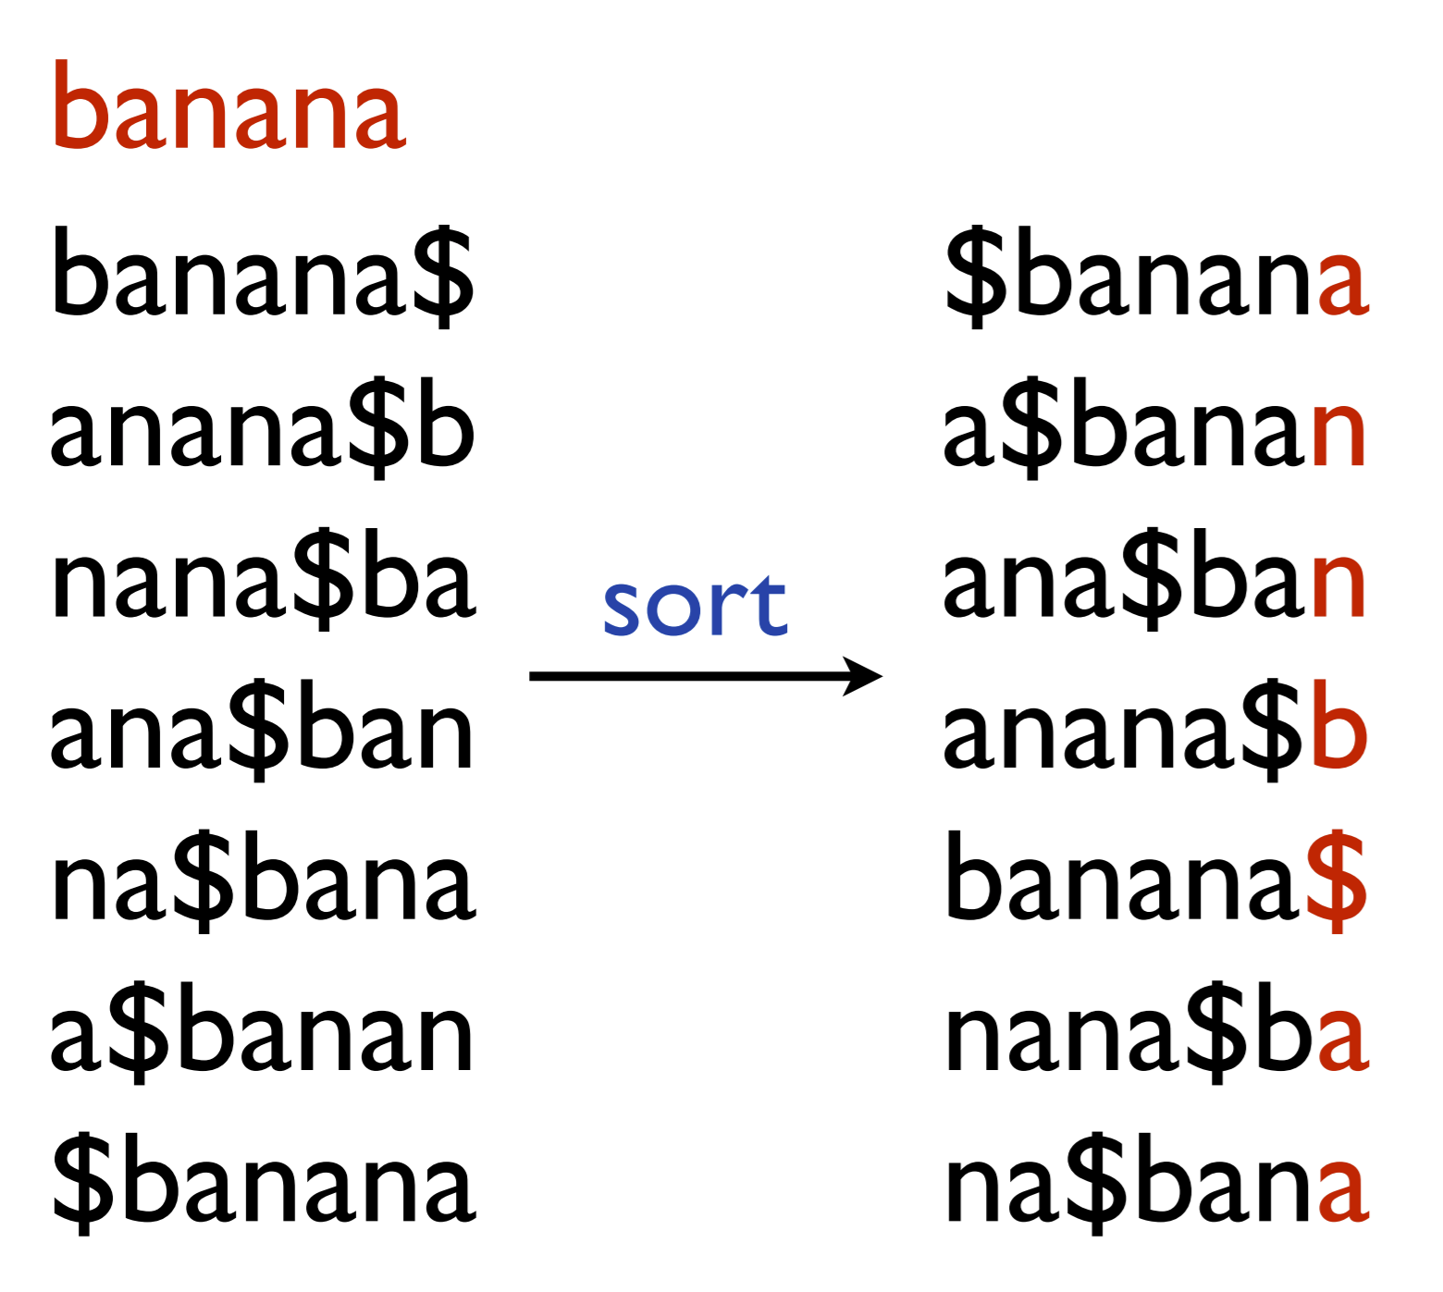
Example
annb$aa

Slide 7
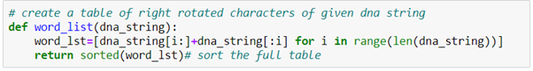
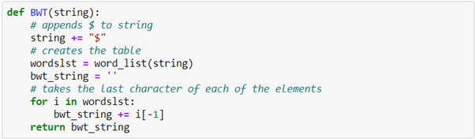
Python Code for BWT

Slide 8
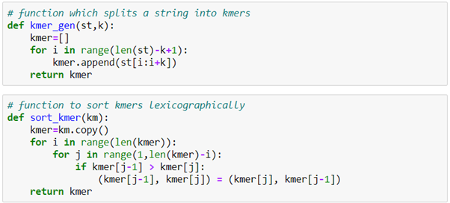
Python Code
for the splitting & sorting of kmers

Slide 9
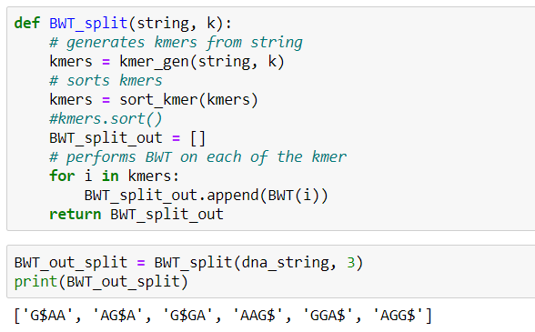
Python Output for BWT

Slide 10
Reverse or Inverse BWT
The process of retrieving the original string from the BWT string is known as Inverse BWT (IBWT)
Methods:
1) Naive
2) LF approach (Last - First)
While the naive method is easier to implement, the LF method is more efficient in terms of speed

Slide 11
Naive Method
The BWT table is recreated from the BWT string.
1st column of the BWT table → BWT string
Prepend the sorted BWT string to the table.
Sort the table containing both the columns
Prepend the BWT string to the table and sort again.
Repeat the process for n times where n = length of the string
Row which ends with the ‘$’ (marker) → original string

Slide 12
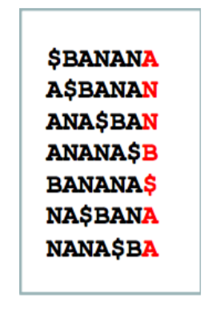
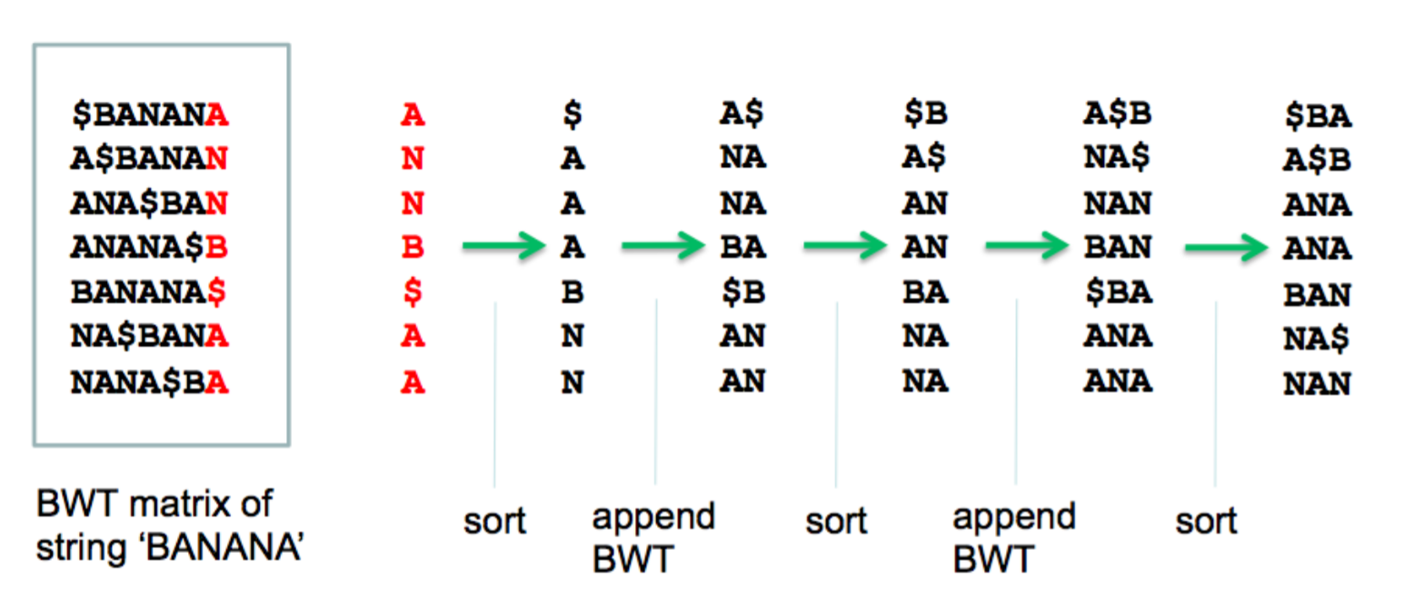
Example

Slide 13
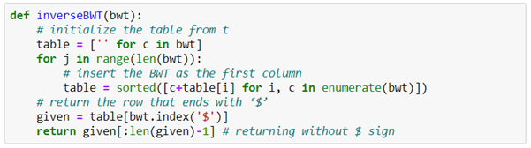
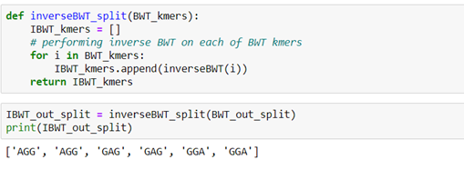
Python Code & Output for IBWT

Slide 14
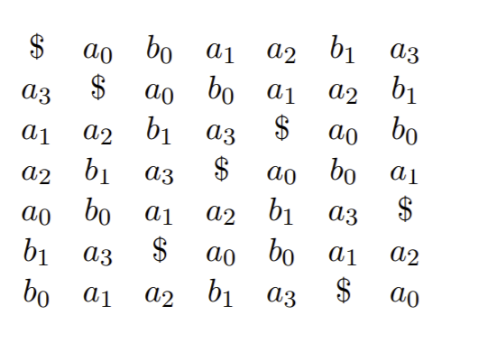
LF Mapping and ranking method
Consider string T is abaaba:
The LF Mapping states: the ith occurrence of a character c in the last column has the same rank as the ith occurrence of c in the first column
Consider the A’s in the last column above, starting at the top.
They have ranks 3, 1, 2 and 0 in that order.
Notes:
Consider string T is abaaba:
The LF Mapping states: the ith occurrence of a character c in the last column has the same rank as the ith occurrence of c in the first column. E.g. look at the as in the last column above, starting at the top. They have ranks 3, 1, 2 and 0 in that order.

Slide 15
Fast IBWT
To recover T from BWT(T): start in the first row, which has $ in the first column
Rows are rotations of T → the last column of the first row contains the character to the left of $ in T: a in this case
From the rank array → the a of rank 0: a0
Recovering the character to the left of a0: possible if row beginning with a0 is known
LF Mapping provides this information
Since a0 has rank 0, it must correspond to the first a in the first column
i.e. the a in the second row.
Notes:
To recover T from BWT(T): start in the first row, which has $ in the first column
Rows are rotations of T → the last column of the first row contains the character to the left of $ in T: a in this case
We know from the rank array that this is the a of rank 0: a0.
Now how to recover the character to the left of a0? We can do this if we know which row begins with a0. But the LF Mapping tells us this. Because a0 has rank 0, it must correspond to the first a in the first column, i.e. the a in the second row.

Slide 16
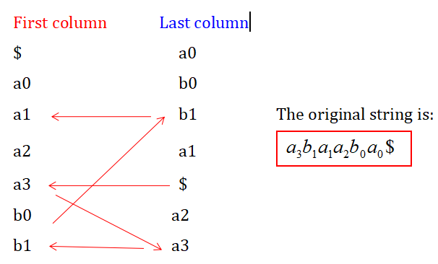
Fast IBWT
Advancing to the second row:
The algorithm looks in the last column and rank array and see that b0 precedes a0
b0 corresponds to the first b in the first column, so the code advances to the sixth row
This process continues until the row with $ in the last column is reached
In this example, the rows would be visited in this order successfully recreating the original string from right to left: a3b1a1a2b0a0$

Slide 17
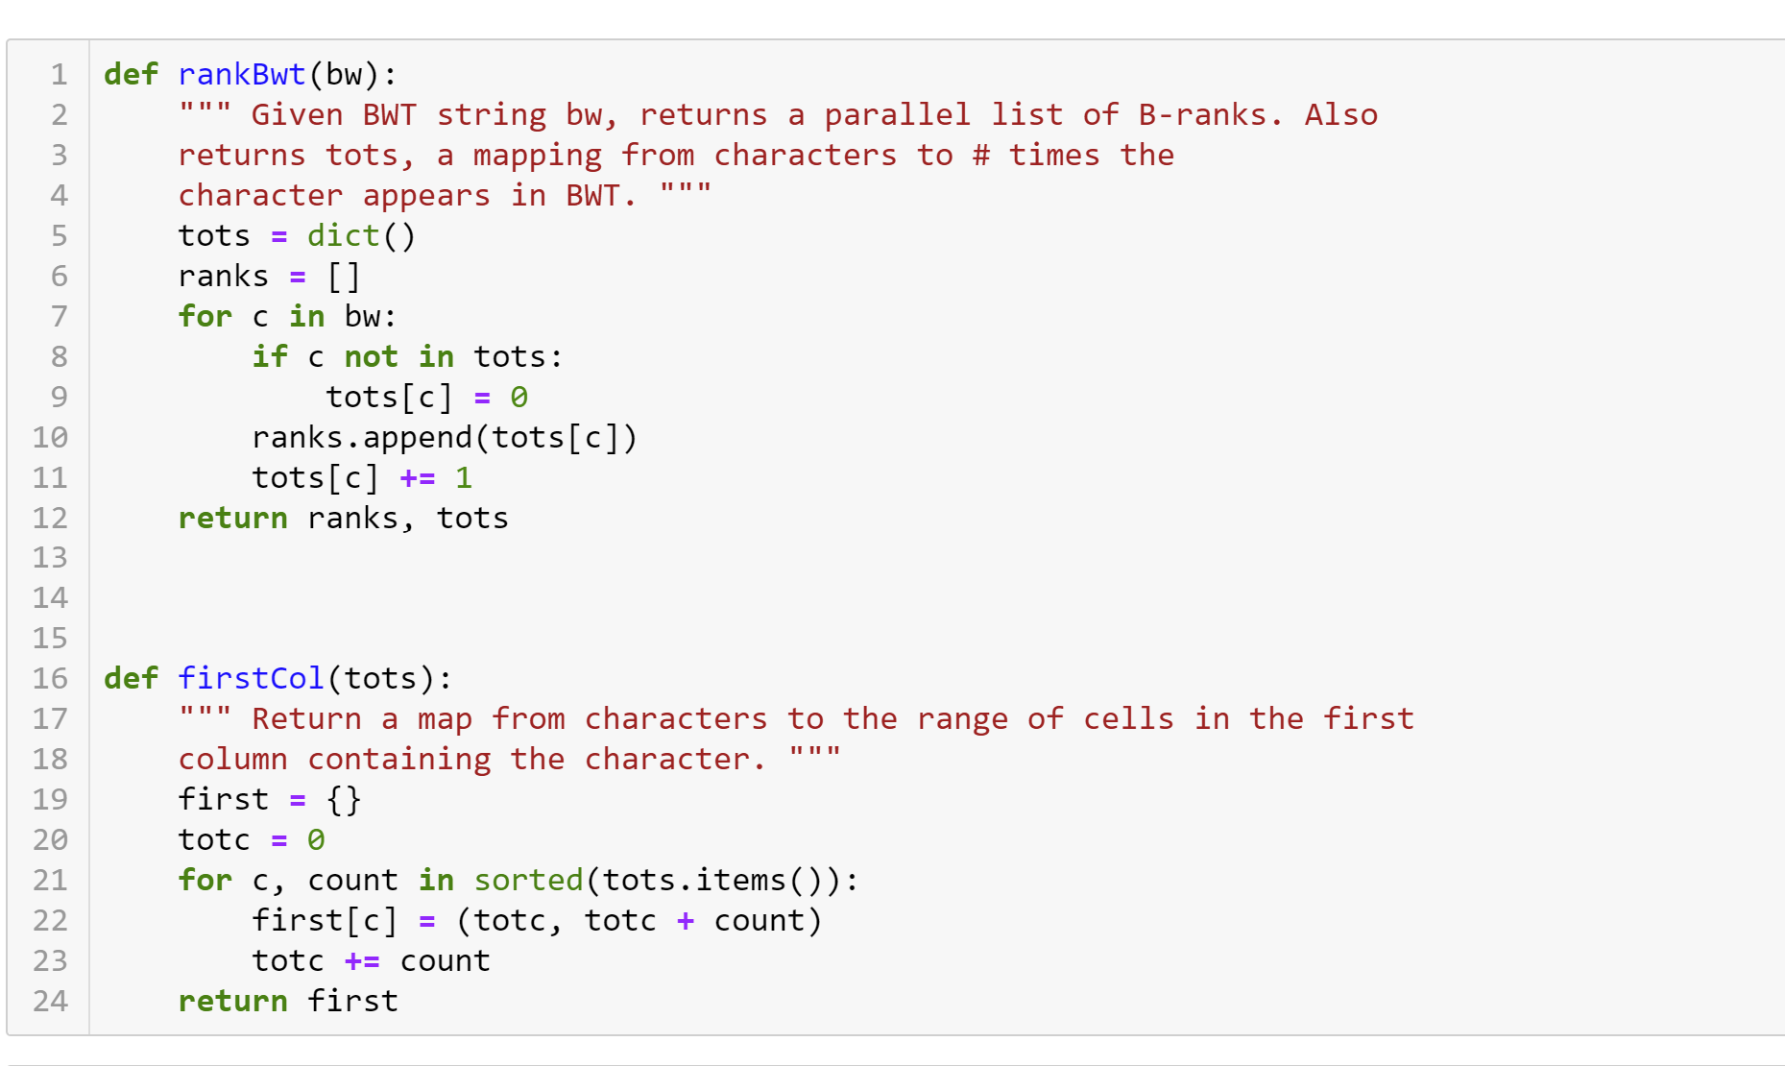
Python - Code

Slide 18
Implementation of Burrows-Wheeler Transform
in JavaScript, Julia and Scala

Slide 19
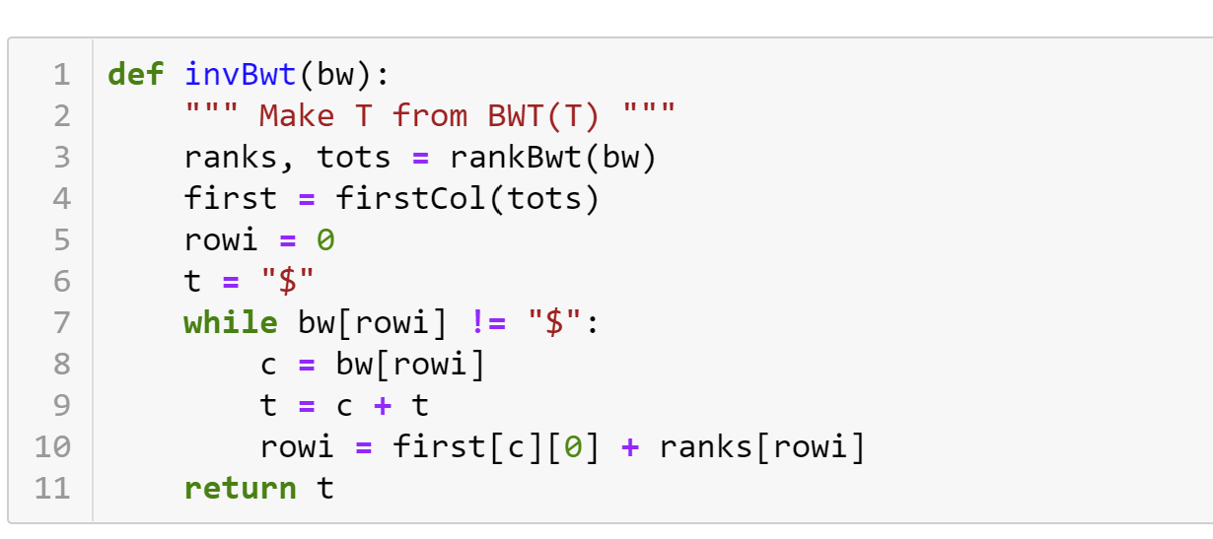
Python - Code

Slide 20
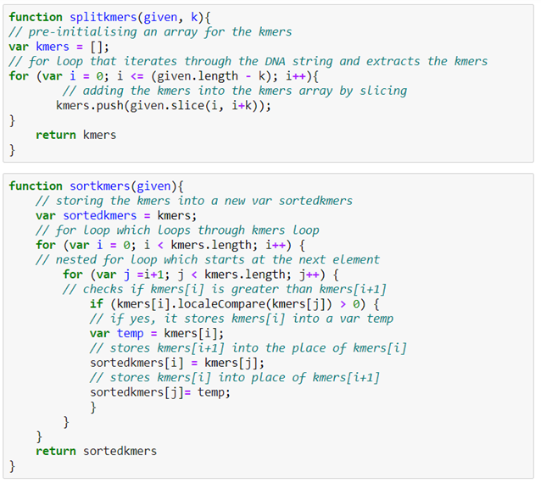
JavaScript - Code
for the splitting & sorting of kmers

Slide 21
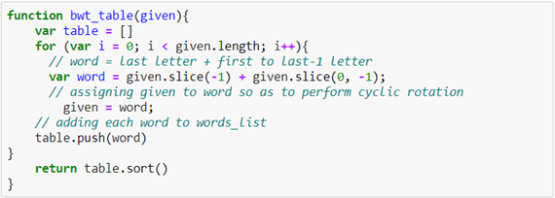
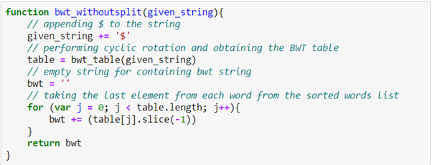
JavaScript - Code

Slide 22
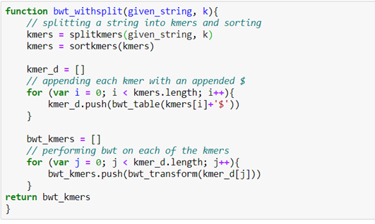
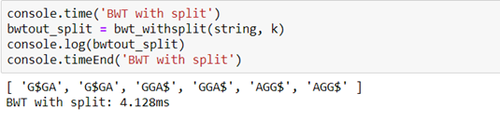
JavaScript - Output

Slide 23
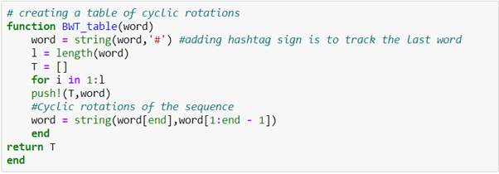
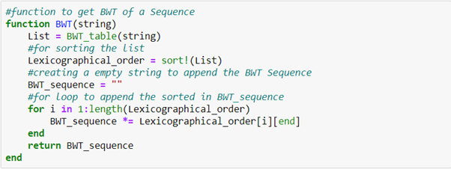
Julia - Code

Slide 24
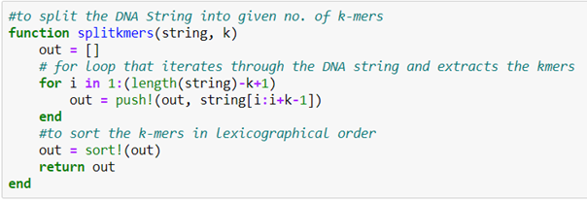
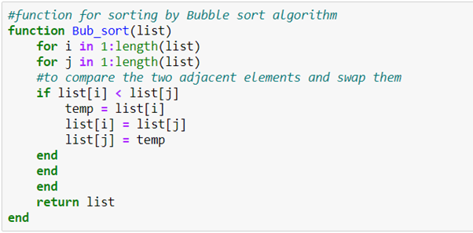
Julia - Code
for the splitting & sorting of kmers

Slide 25
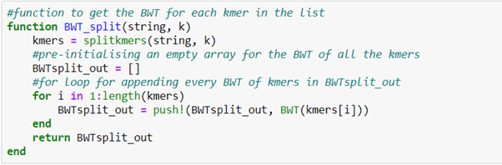
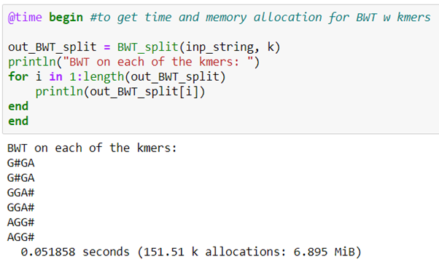
Julia - Output

Slide 26
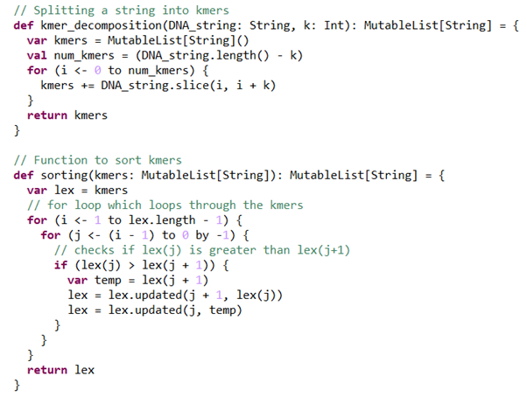
Scala - Code
for the splitting & sorting of kmers

Slide 27
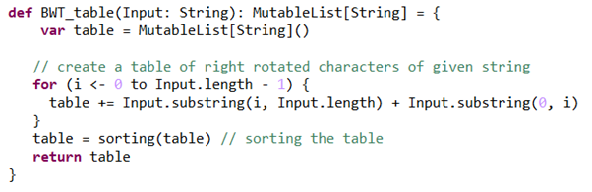
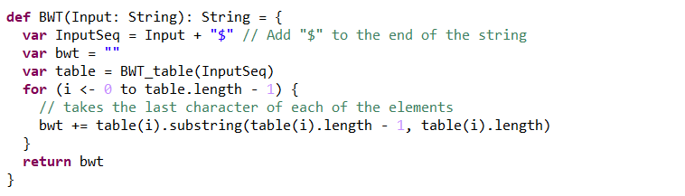
Scala - Code

Slide 28
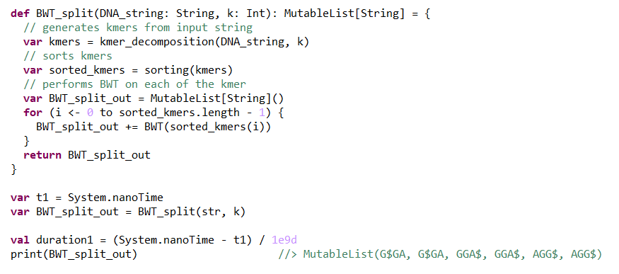
Scala - Output

Slide 29
Implementation of Inverse Burrows-Wheeler Transform
in JavaScript, Julia and Scala

Slide 30
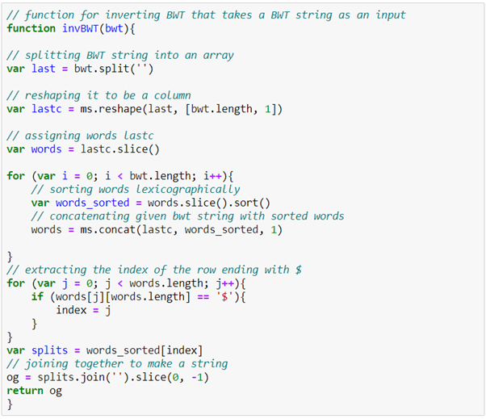
JavaScript - Code

Slide 31
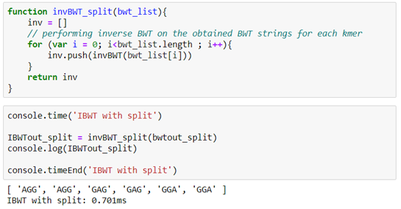
JavaScript - Output

Slide 32
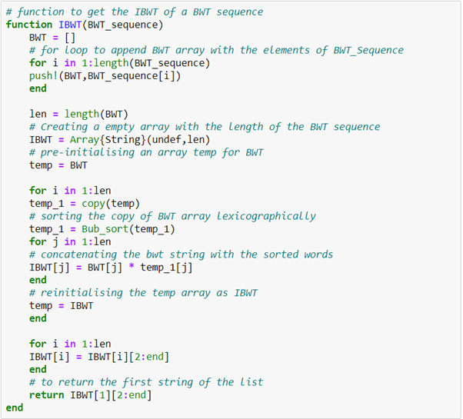
Julia - Code & Output

Slide 33
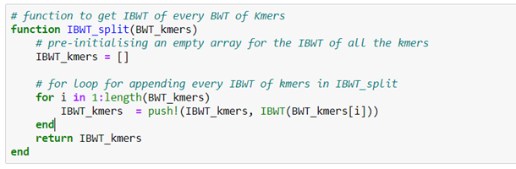
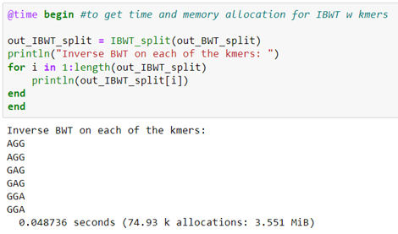
Julia - Output

Slide 34
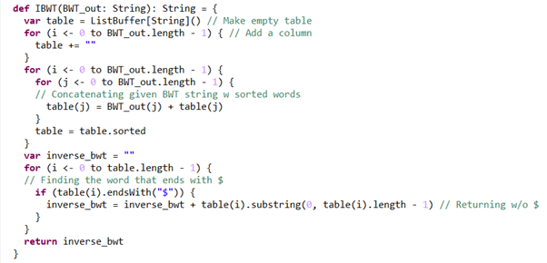
Scala - Code & Output

Slide 35
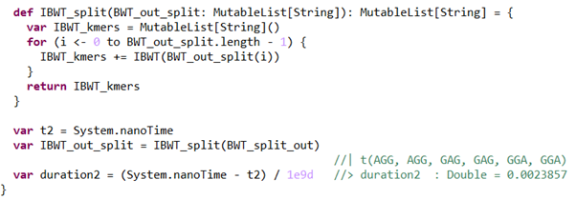
Scala - Output

Slide 36
Analysis of time complexity (String length: 500)
Python
JavaScript
K | Time taken for BWT (s) | Time taken for IBWT (s)
5 | 0.07854127883911133 | 0.008981466293334961
10 | 0.1056818962097168 | 0.01595330238342285
15 | 0.12172460556030273 | 0.023958921432495117
20 | 0.14061832427978516 | 0.040889739990234375
25 | 0.10578417778015137 | 0.05287909507751465
K | Time taken for BWT (s) | Time taken for IBWT (s)
5 | 0.016947 | 0.04192
10 | 0.018083 | 0.11265
15 | 0.020553 | 0.309325
20 | 0.019817 | 0.718586
25 | 0.021327 | 1.266435
Scala
Julia
K | Time taken for BWT (s) | Time taken for IBWT (s)
5 | 1.4173541 | 0.0336926
10 | 1.4411696 | 0.0584635
15 | 1.4433011 | 0.08408
20 | 1.4302153 | 0.0866745
25 | 1.6724986 | 0.1091746
K | Time taken for BWT (s) | Time taken for IBWT (s)
5 | 0.138038 | 0.112778
10 | 0.125184 | 0.109100
15 | 0.131068 | 0.139528
20 | 0.140327 | 0.196783
25 | 0.175064 | 0.631486

Slide 37
Analysis of time complexity (String length: 2000)
Python
JavaScript
K | Time taken for BWT (s) | Time taken for IBWT (s)
5 | 0.3420865535736084 | 0.02496957778930664
10 | 0.2981719970703125 | 0.05086636543273926
15 | 0.37403035163879395 | 0.10572409629821777
20 | 0.38300490379333496 | 0.18550515174865723
25 | 0.37602734565734863 | 0.279221773147583
K | Time taken for BWT (s) | Time taken for IBWT (s)
5 | 0.140287 | 0.121380
10 | 0.152774 | 0.565675
15 | 0.186439 | 1.189235
20 | 0.192212 | 2.592653
25 | 0.190146 | 4.772273
Scala
Julia
K | Time taken for BWT (s) | Time taken for IBWT (s)
5 | 98.2277459 | 0.1358753
10 | 74.7768807 | 0.0930074
15 | 75.9185703 | 0.1274475
20 | 74.7621887 | 0.1845562
25 | 94.1470351 | 0.7468491
K | Time taken for BWT (s) | Time taken for IBWT (s)
5 | 0.193696 | 0.177949
10 | 0.246129 | 0.251371
15 | 0.237819 | 0.396306
20 | 0.278681 | 0.661648
25 | 0.331872 | 1.011497

Slide 38
Analysis of time complexity (String length: 20000)
Python
JavaScript
K | Time taken for BWT (s) | Time taken for IBWT (s)
5 | 2.8863234519958496 | 0.17553305625915527
10 | 3.196842908859253 | 0.5006504058837891
15 | 3.436218023300171 | 0.893338680267334
20 | 3.259413480758667 | 1.512526035308838
25 | 3.776116132736206 | 2.1897740364074707
K | Time taken for BWT (s) | Time taken for IBWT (s)
5 | 12.2921067 | 0.867638
10 | 14.293564 | 4.187898
15 | 18.293467 | 13.526163
20 | 18.450545 | 27.880089
25 | 18.146937 | 52.809712
Julia
K | Time taken for BWT (s) | Time taken for IBWT (s)
5 | 1.101833 | 1.145914
10 | 1.230348 | 1.852064
15 | 1.567450 | 3.473270
20 | 2.120496 | 5.755633
25 | 2.442508 | 9.129068

Slide 39
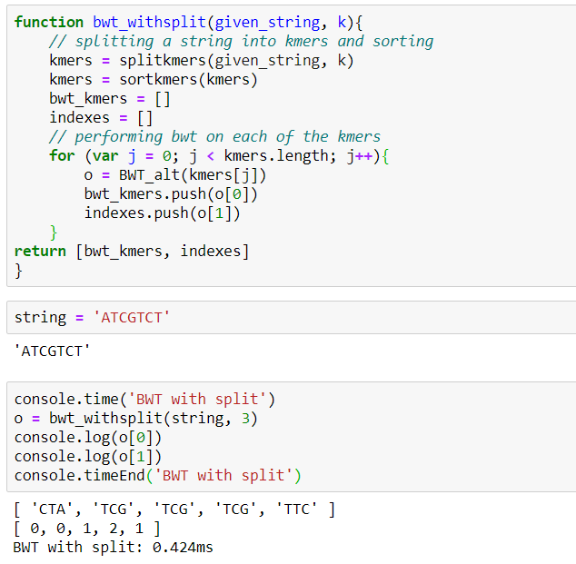
Experimenting with Reconstruction of Genome Sequence using BWT:
The output of the BWT shows that the kmers have lost their initial property which is the basis of the suffix-prefix based methodologies such as Eulerian and Hamiltonian
For example, the first kmer ‘ATC’ is not even present in the output of the BWT.

Slide 40
Reconstruction of Genome Sequence
Since the kmers were sorted before BWT and IBWT was performed, it isn’t possible to reconstruct the original sequence without the usage of string reconstruction methods
Methods been used in this project:
Hamiltonian
Eulerian
The output of the Inverse BWT function was fed into codes written for the 2 algorithms to ensure that the original string is being retrieved

Slide 41
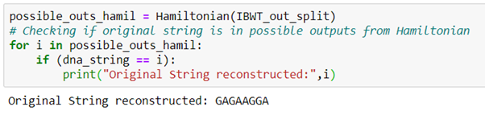
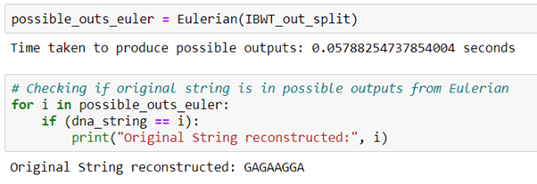
Outputs for String Reconstruction

Slide 42
Pattern Counting:
Problem Statement:
Given a genome sequence & a particular pattern, finding the number of the occurences of the pattern using the BWT string
Using Last-First property
Rank the characters according to the last column → same for first column
Starting from the pattern’s last character, the algorithm traverses through the first column given a certain range of that character in the first column.

Slide 43
Pattern Counting:
The next step is continuing the same with the next longest suffix and we keep doing this until the characters of the full pattern is complete.
Once the longest suffix is the pattern we will have narrowed down the range to a single row(s) indicating the presence of these patterns in the bwm. If the pattern doesn’t exist we return the message stating “pattern doesn’t exist”.
The reason this is optimal is because only 3 indices are being used:
First column
Last column
Rank array

Slide 44
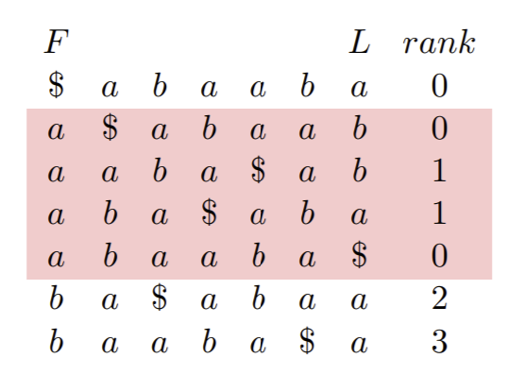
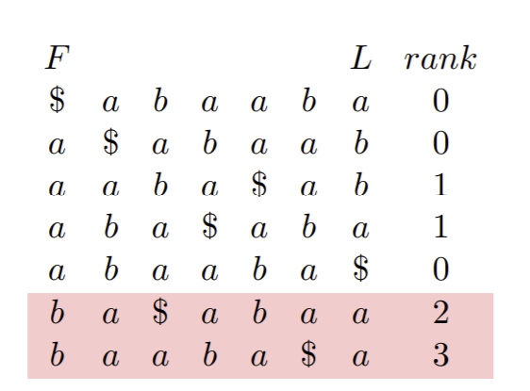
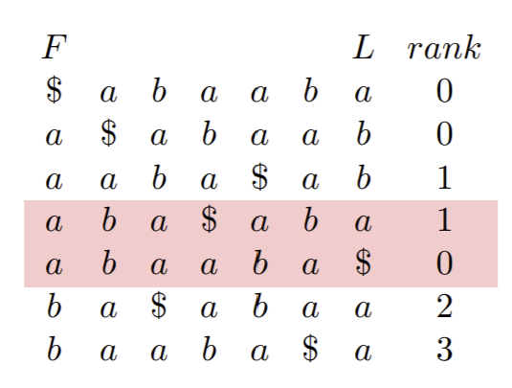
Example - aba:

Slide 45
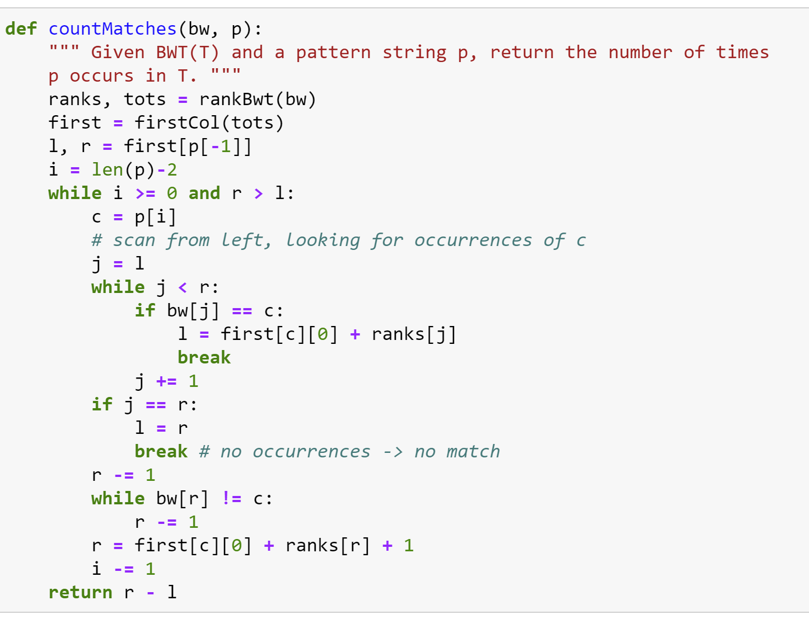
Python - Code

Slide 46
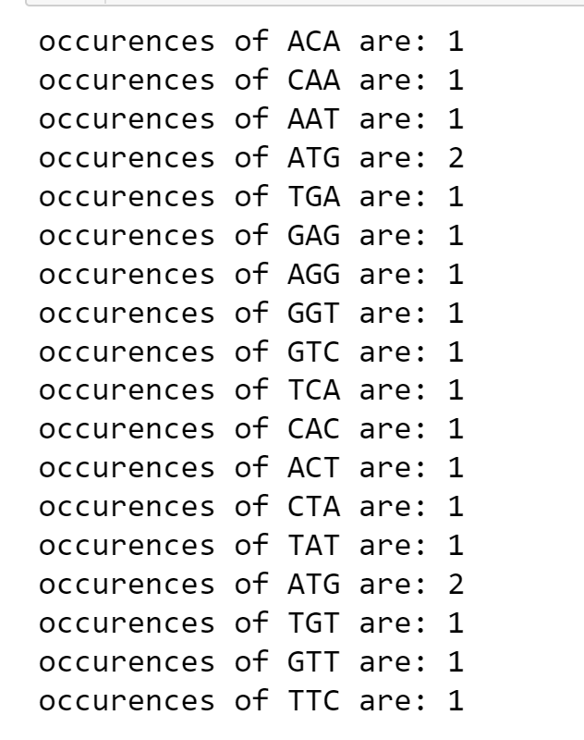
Python - Output

Slide 47
Pattern Matching:
Problem Statement:
Finding the position of a particular pattern in the original sequence using only the BWT string
Using the BWT string, the BWT table can be constructed using cyclic rotations
The index of the last letter of the given pattern in the first column is computed and the algorithm checks if these rows end with the 2nd last letter in the pattern
This process is done iteratively for the length of the given pattern

Slide 48
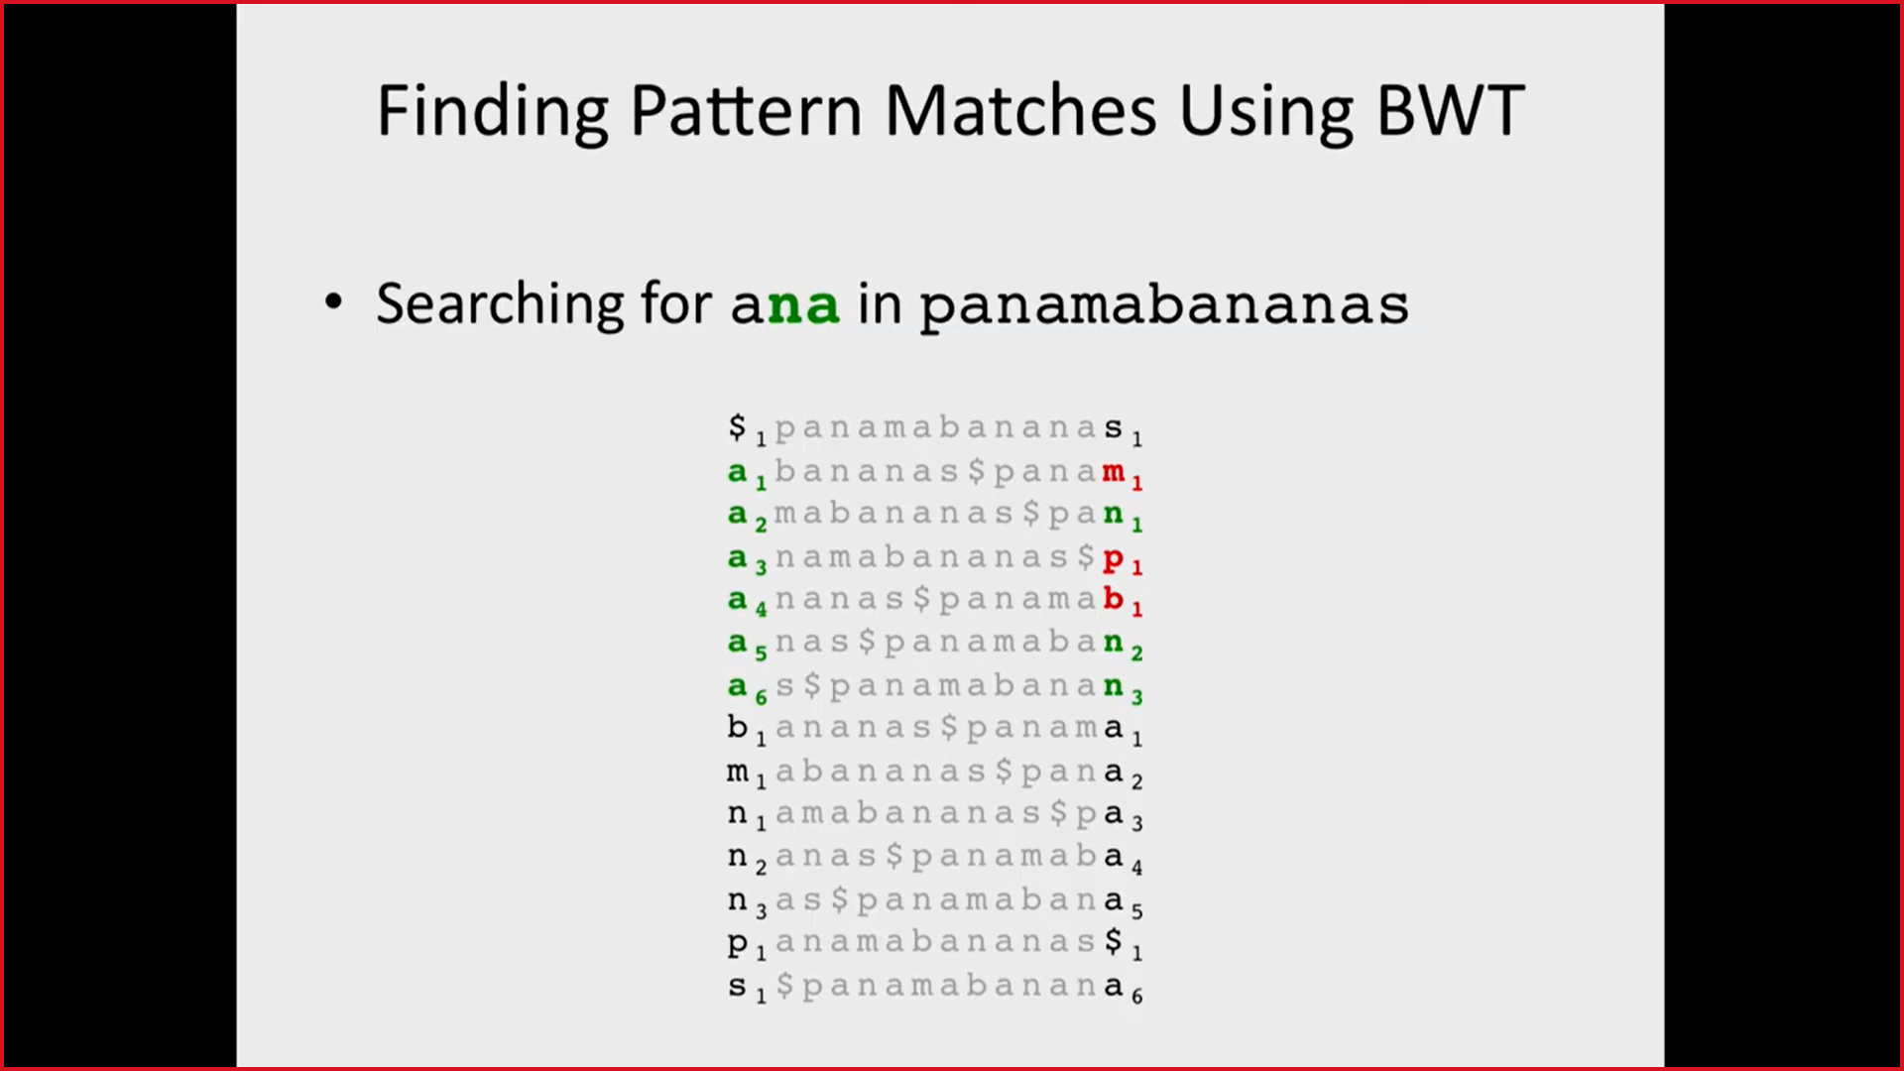
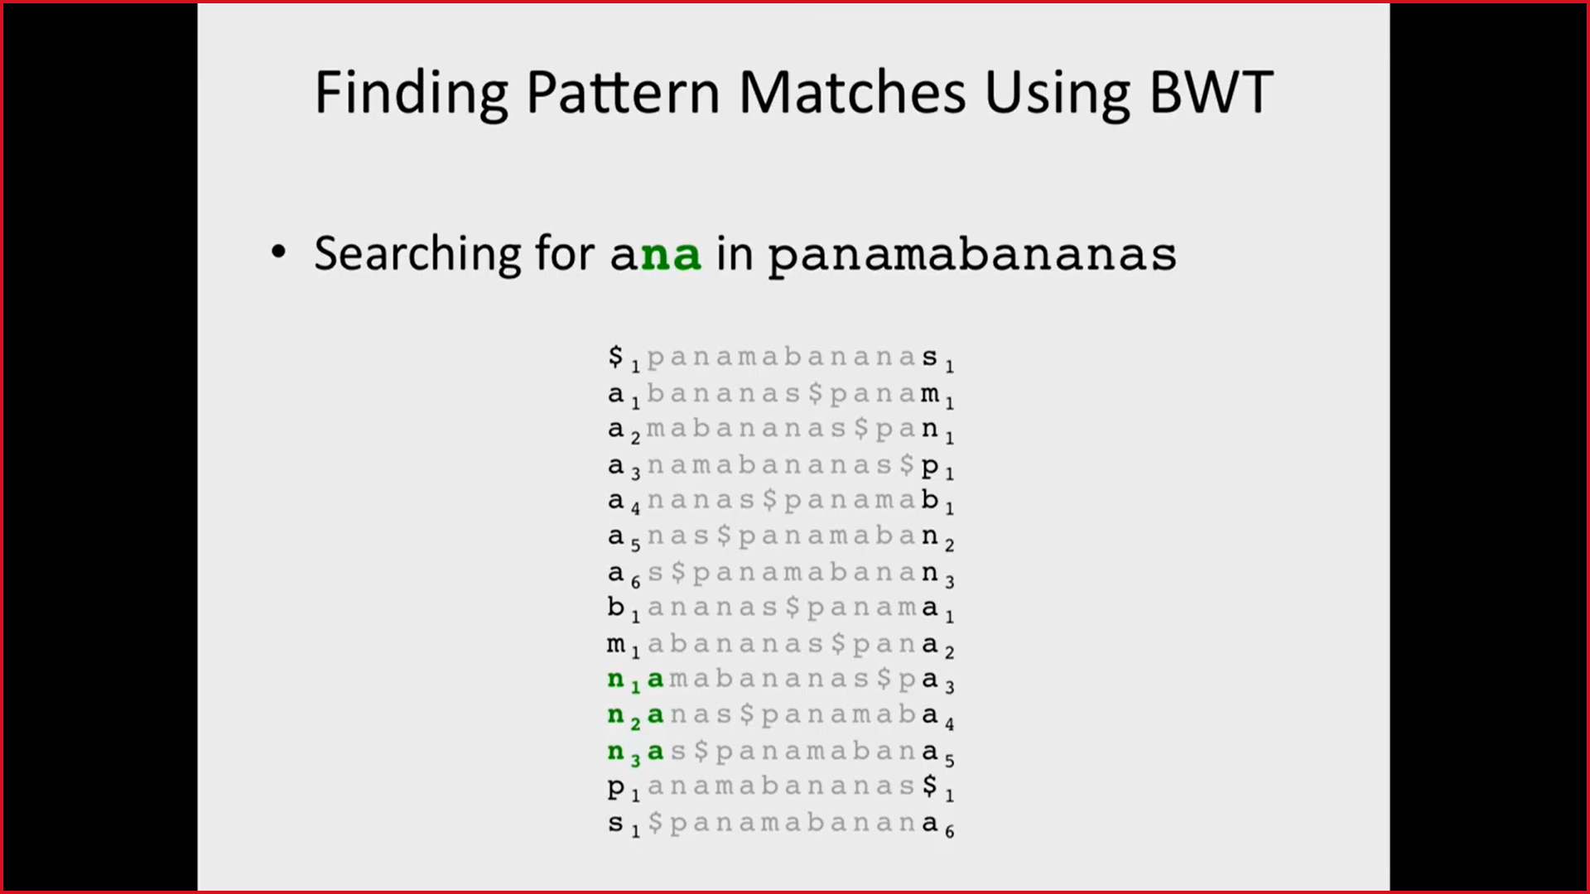
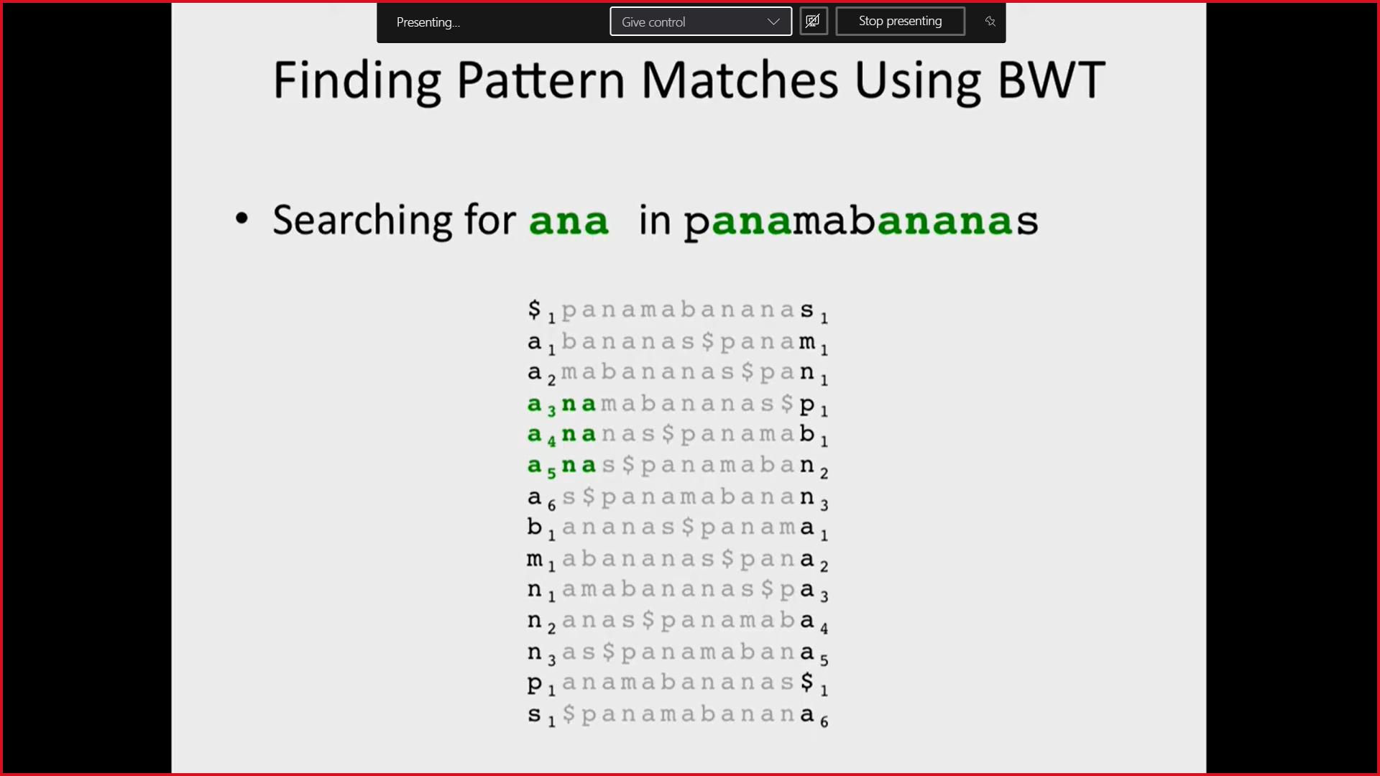
Pattern Matching:
Searching for ‘ana’ in panamabananas
Step 1:
Identifying rows beginning with last element of pattern
Step 2:
Identifying the index of the 2nd last letter in the query in the 1st column and checking if it ends with the 1st letter in the query
Step 3:
Using the indexes obtained in the previous step, the rows containing the pattern can be found

Slide 49
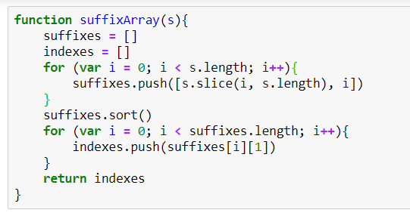
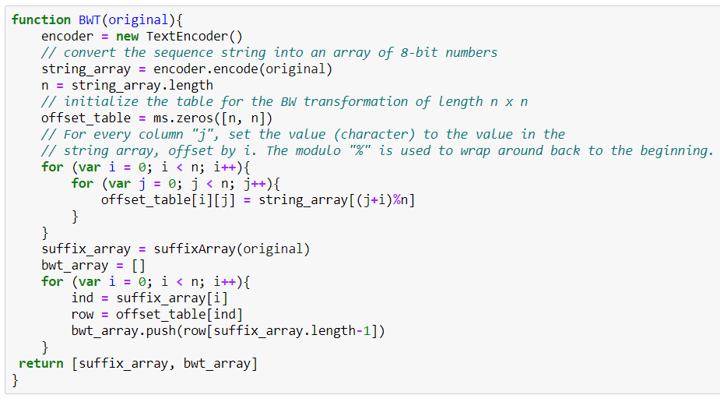
JavaScript - Code

Slide 50
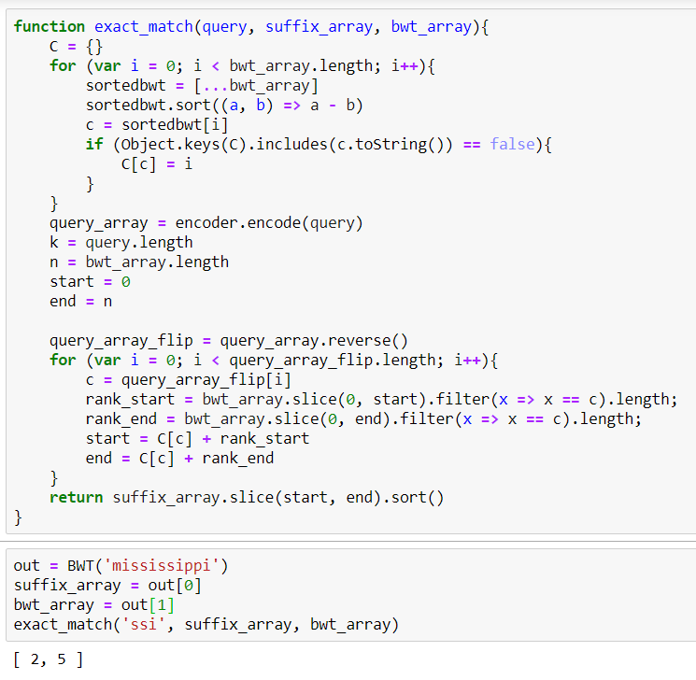
JavaScript - Code & Output

Slide 51
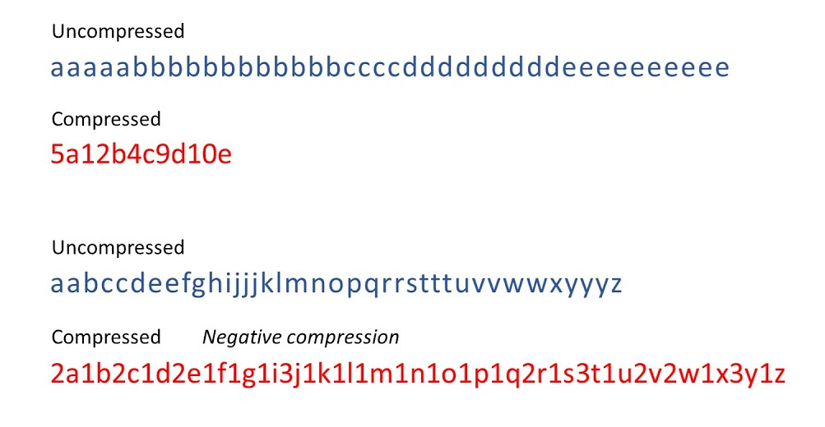
Compression: Run-Length Encoding
Burrows-Wheeler Transform creates more runs which in turn allows for better compression
One such technique of compression is Run-Length encoding

Slide 52
Pipeline for Compression and Retrieval
BWT
RLE - Run Length Encoding
IBWT
RLD - Run Length Decoding

Slide 53

Python Code for Encoding:

Slide 54

JavaScript Code for Encoding:

Slide 55


Python Code for Decoding:

Slide 56

JavaScript Code for Decoding:

Slide 57
Applications for BWT compression
Bioinformatics & Computational Biology
Linux command: bzip2
Full-text compressed indexes
Prediction
Entropy Estimation

